Slide 1
Final Year Project
Title: Network Intrusion Detection System using Machine Learning
Domain: Machine Learning
Name: HARISH B
Roll No: 2019202016
MCA (Regular)
Guide: Ms.B.Siva Shankari

Slide 2
Introduction
A machine learning-based Network Intrusion Detection System (ML-NIDS) that detects anomalies through ML algorithms by analyzing behaviors of protocols.
The ML-NIDS learns the characteristics of attack traffic based on training data, so it, too, is inevitably vulnerable to attacks that have not been learned, just like pattern-matching machine learning.

Slide 3
Survey
Name | Author | Year | Problem Address | Methods and Algorithms used | Pros and Cons | Future Works
Robust Network Intrusion Detection System Based on Machine-Learning With Early Classification | TAEHOON KIM AND WOOGUIL PAK | 2022 | cannot detect new attacks because they only learn existing patterns and use them to detect those attacks | Proposed NIDS Classification | performances improved when the proposed method was applied | extend this current result to support multiple features
Evaluating and Improving Adversarial Robustness of Machine Learning-Based Network Intrusion Detectors | Dongqi Han, Zhiliang Wang, Ying Zhong, Wenqi Chen, Jiahai Yang, Shuqiang Lu, Xingang Shi, Xia Yin | 2021 | gray/black-box traffic-space adversarial attacks to evaluate the robustness of ML-based NIDS | KitNET, Multi-Layer Perceptron (MLP), Logistics Regression (LR), Decision Tree (DT) and Support Vector | affordable execution cost, and is effective even without any knowledge of the targeted systems | theoretically secure systems from the perspective of defense
An Efficient Intrusion Detection Method Based on Dynamic Autoencoder | Ruijie Zhao, Jie Yin, Zhi Xue, Guan Gui, Bamidele Adebisi, Tomoaki Ohtsuki, Haris Gacanin, and Hikmet Sari | 2021 | existing intrusion detection methods usually use principal component analysis (PCA) and autoencoder to reduce the feature dimension to achieve the goal of lightweight | Proposed LDAN Method | proposed method has better detection accuracy and robustness | new perspective to solve the performance and implementation challenges of intrusion detection methods

Slide 4
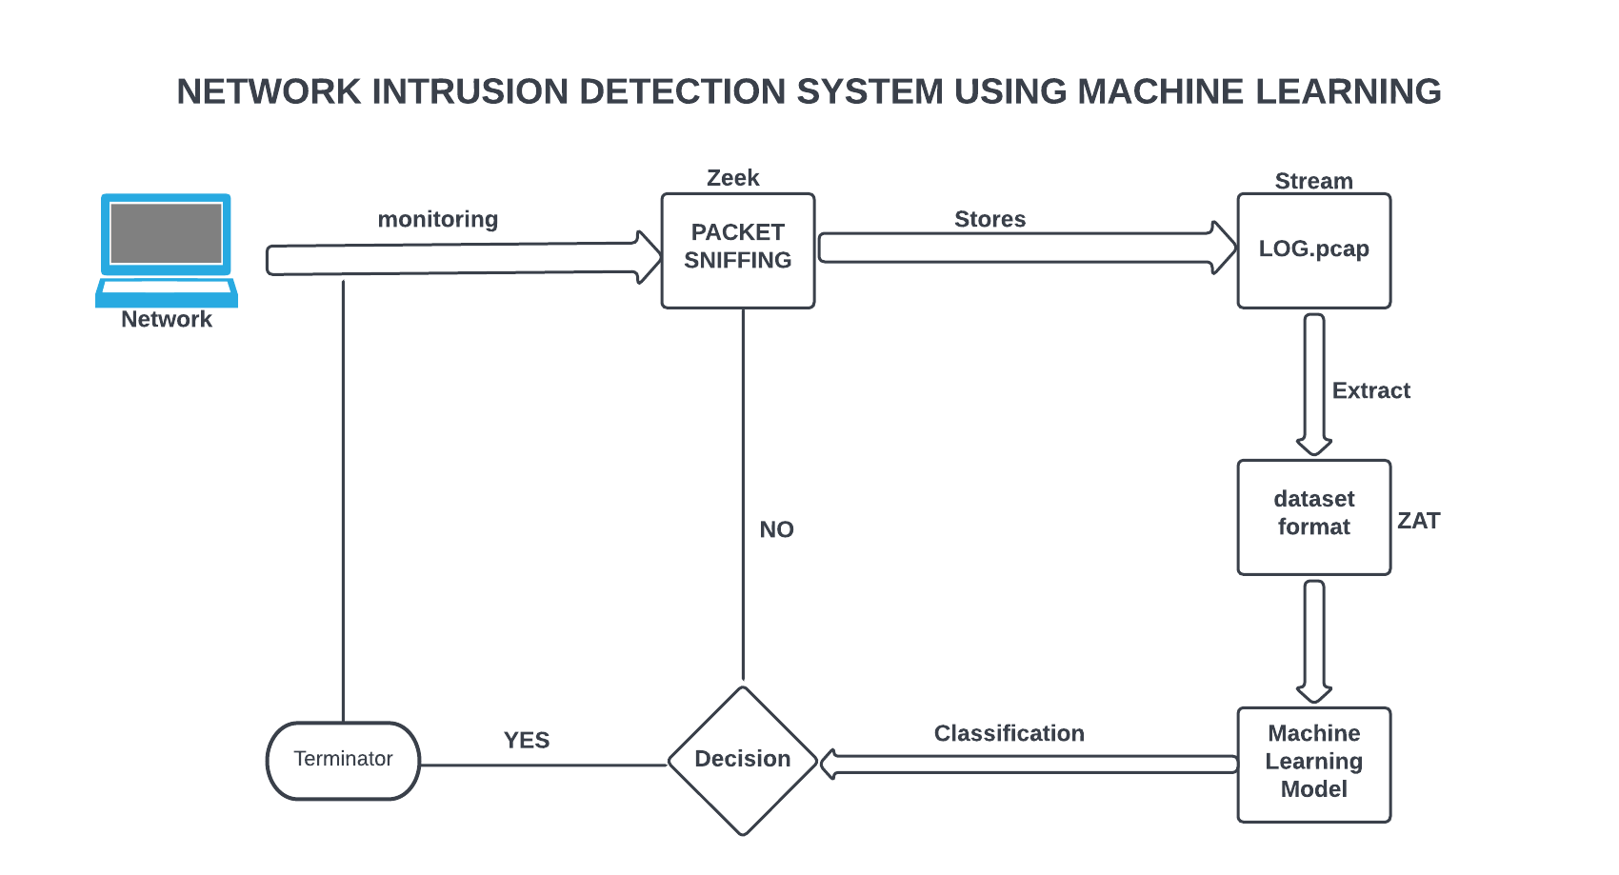
Block Diagram

Slide 5
Objective Proposed Project Work
An ML-model can be trained from a dataset with malicious and traffic. This model can then be used to detect malicious traffic flows in .pcap log files.
ZAT is used to extract features based on time and data size from network traffic.
The features are then analyzed with Machine Learning in Scikit-learn in order to detect malicious traffic using CICIDS2017 dataset.

Slide 6
The CICIDS2017 dataset consists of benign traffic generated by users mixed with malicious traffic from the most common(according to McAfee 2016) cyber attacks.
The traffic was recorded in a controlled network environment over 5 days and include attacks such as Brute Forcing, DoS and Botnets. The dataset is delivered as a set of packet capture (PCAP) files, which can be replayed on a computers network interface.
The dataset also comes with a time schedule for the attacks and a spreadsheet file which contains more extracted features for each traffic flow, labeled as <name-of-attack>
• Forward Inter Arrival Time: Time between two packets in forward direction.
• Backward Inter Arrival Time: Time between two packets in backward direction.
• Flow Inter Arrival Time: Time between two packets in either direction.
• Active: Duration of sending packets for before going idle.
• Idle: Duration of idleness before starting to send packets again.
• Flow Bytes per second: Bytes sent per second in either direction.
• Flow packets per second: Packets sent per second in either direction.
• Duration: Time between the first and the last packet of the flow.

Slide 7
Novelty
Machine Learning Model can result in low False Alarm Rate and high detection rate.
Intrusion Detection System (IDS) is used to detect all these kinds of malicious activities happening on the network and indicates the network administrator to get the data secured against these attacks
IDS detects if any one trying to have access and it immediately alerts the administrator to take action .Hence IDS are the security systems detecting various activities that attack on the network and keeps our systems safe.

Slide 8
Tools and Programming Language used:
Tools
Network-Monitor:
Zeek
Extract:
ZAT(Zeek Analysis Tool)
Programming Language
Library:
Scikit-learn
Pandas
Language:
Python

Slide 9
References:
R. Zhao et al., "An Efficient Intrusion Detection Method Based on Dynamic Autoencoder," in IEEE Wireless Communications Letters, vol. 10, no. 8, pp. 1707-1711, Aug. 2021, doi: 10.1109/LWC.2021.3077946.
Robust Network Intrusion Detection System Based on Machine-Learning With Early Classification | IEEE Journals & Magazine | IEEE Xplore
Evaluating and Improving Adversarial Robustness of Machine Learning-Based Network Intrusion Detectors | IEEE Journals & Magazine | IEEE Xplore

